Slide 1
Mobile Advance 2026
Programme Overview

Slide 2
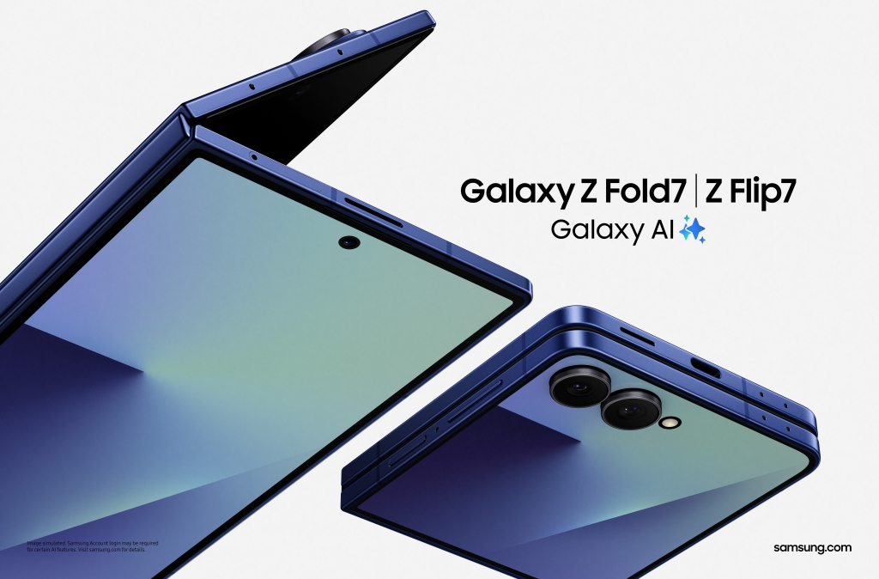
Samsung Mobile Advance summary
Up to $45k Funding
(no equity)
Apply by 30 June 2026
Samsung Loan Devices
6-month
Project
Support by Samsung R&D
Project Start Jan 2027
Pitch Day to Samsung Panel

Slide 3
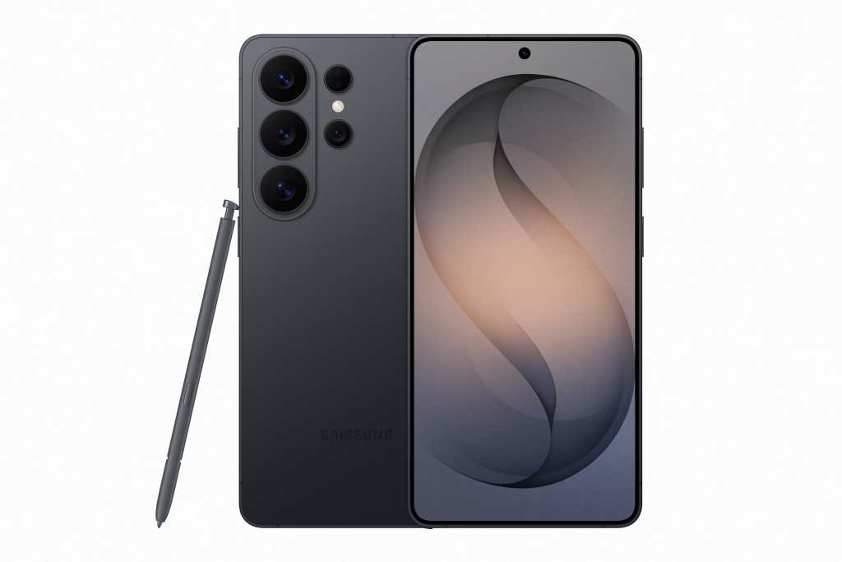
Samsung Mobile Advance
What is it?
Samsung Mobile Advance is a grant funding scheme for new proof-
of-concept projects that are specifically tailored to Samsung Mobile devices
It is an open call for project proposals from Chinese companies and
organizations, with two rounds of judging, including a Pitch Day event
What do I get?
Samsung will provide up to $45k in grant funding as well as limited
technical and project support and loan devices for a period of six months to
enable the winning project ideas to be developed
Proposals will gain exposure to a wide range of Samsung staff that will evaluate
and select those that have the highest potential to add value to our product range
After the six month program, the developed Proof of Concept projects will be evaluated and considered by Samsung Mobile for further partnership opportunities*
What does Samsung get?
Samsung asks for first priority to complete an evaluation of the Proof of Concept and to finalize any future collaboration steps for no more than six months once the development phase of the project is completed
* e.g. technology licensing, investment, joint development, deployment in Samsung products

Slide 4
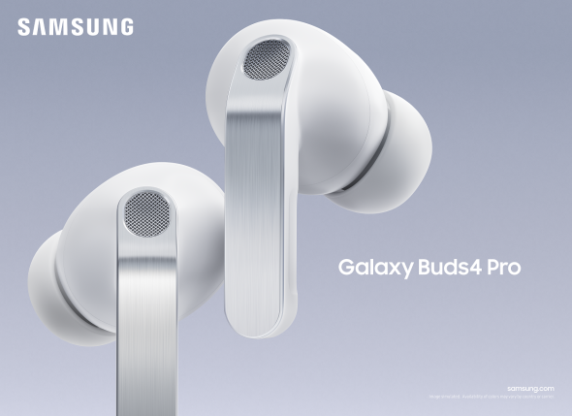
How to apply
  Complete a Samsung Mobile Advance proposal form and submit to: shaohui.wang@samsung.com
      You can submit multiple applications if you wish
      Our team is happy to provide guidance before you apply
Evaluation criteria
  Level of innovation and uniqueness of core technology
  Value added to Samsung Mobile devices
  Feasibility to integrate into current or future Samsung Mobile devices
Dates
  Application Deadline: Midnight on 30th (Tues) June, 2026
  Pitch Day: Successful proposal applicants will be invited to a Pitch Day event following selection. The date of the pitch day will be agreed at least 1 week in advance
  Project Start: The 6-month projects are expected to begin in January 2027
Facilitated by
  Samsung R&D China

Slide 5
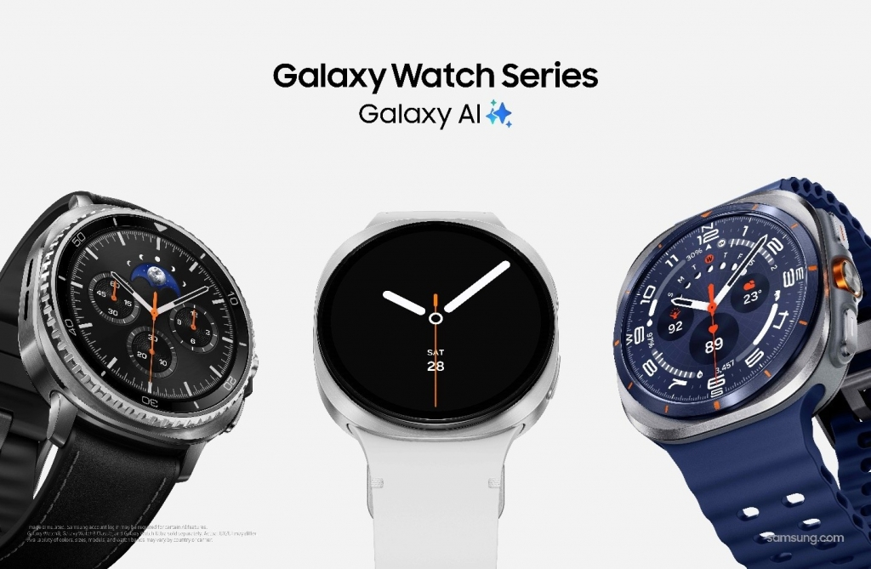
Samsung Mobile Advance 2026 schedule
April 2026 | 30 June | July | August | September | October | December | Jan 2027 | June 2027
Application Start | Application Deadline | Review Phase | Shortlist selection & Invitation to Pitch Day | Pitch Day | Final selection & Contract discussion | Contract signed | Project Start | Project end & Demo Day
We intend to hold the Pitch Day as an online event but we may also be able to arrange in-person pitch at our China office
The Demo Day may be a in-person event in our China office or an online event, where you will present the outcome of your project to relevant product and R&D teams in Samsung

Slide 6
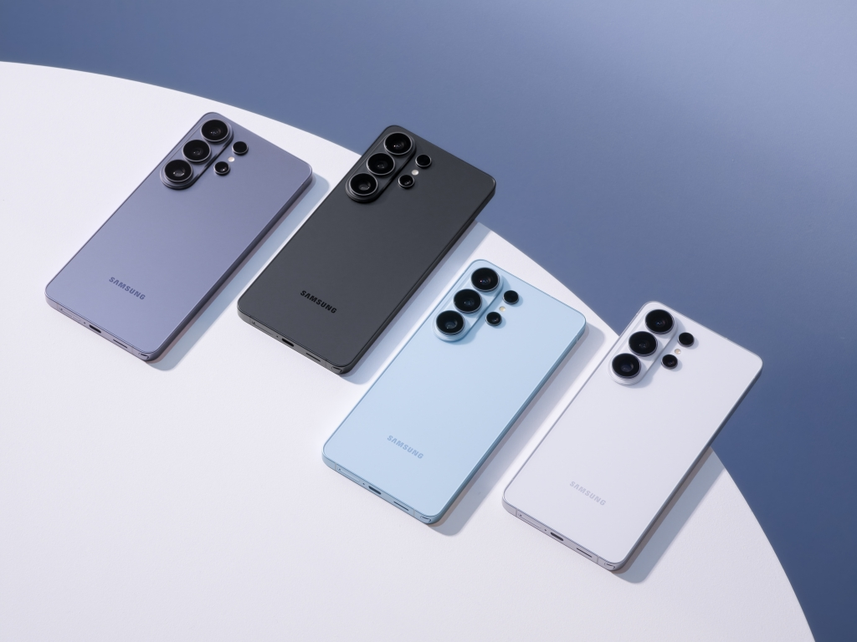
Why you should apply
The programme provides wide visibility across various product and R&D teams at Samsung Mobile. It is a fast-track way to get your ideas and technology in front of the eyes of key decision-makers at Samsung Mobile
Even if your proposal is not selected for funding, you may get valuable feedback from our team that will help you improve on your proposal or target new use-cases
The programme is focused on getting third-party technology into our products. Several alumni have received further investment and have commercialised their solutions with Samsung

Slide 7
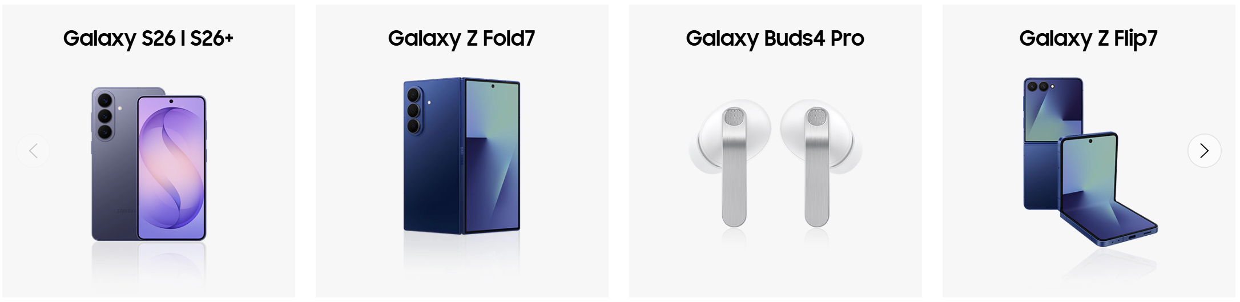

What we are looking for…
Broad themes of interest include (but are not limited to): Camera, Audio, Health, on-device language/vision AI, AR/VR, Power, Advanced Materials, Sensors, Wearables, Foldable design
Innovative software or hardware technology projects that can enhance and add value to the next generation of Samsung Mobile product range
Examples of current Samsung Mobile products include the Galaxy S-, and Z-series phones, Galaxy Watch, Galaxy Ring, Galaxy Buds and Galaxy XR devices
* Products and services that rely on accessories are overall slightly less likely to be considered for Samsung Mobile Advance

Slide 8
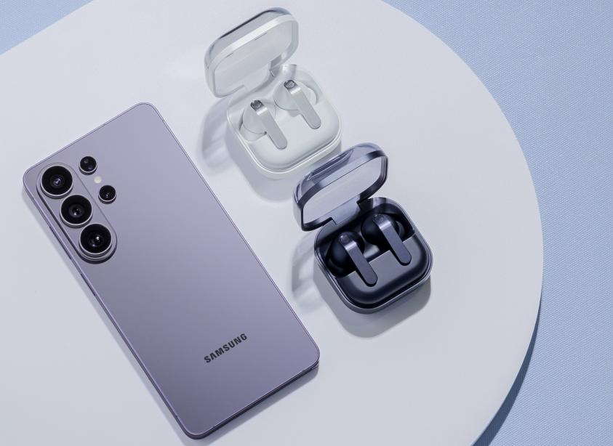
Samsung support provided
Funding of approximately $45k* based on pre-agreed milestones & schedule, for development of the Proof of Concept (PoC) idea for Samsung Mobile R&D
A limited number of Samsung Mobile devices are available to loan for development and testing purposes
Assistance from Samsung R&D teams to deliver the PoC aligned with expectations of Samsung Mobile**
* Or RMB equivalent subject to currency rate fluctuations at the time of contract
** Samsung will not share either its own or other current partners IP or offer a guarantee that it can fix any technical issues that may arise from selected partners projects.

Slide 9
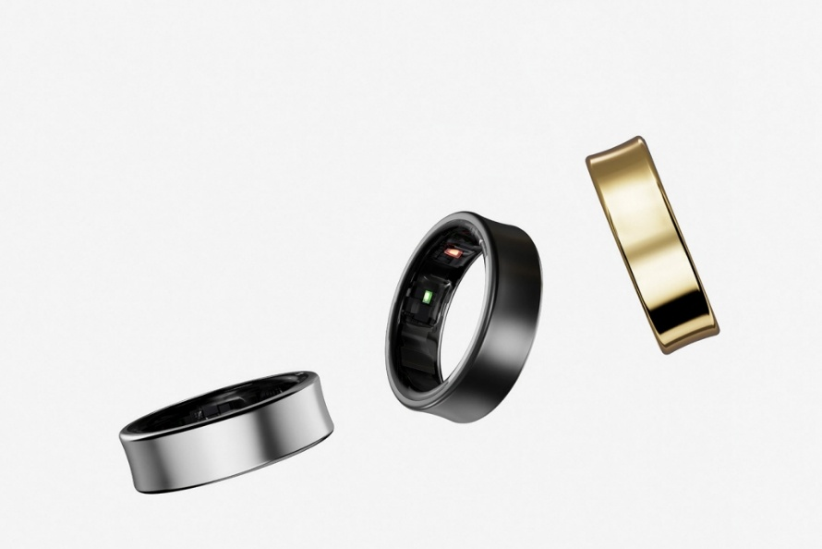
FAQ
Is the program only open for start-ups?
No. The program is available for any type of company, or organisation including early stage start-ups, established companies and research institutes. We only expect that the applicant is fully registered as a company or other legal entity with which we can create a contract.
Will Samsung take any equity as part of the program?
No. We do not take equity in participating companies. The focus is on the project and technology only.
Is it possible to participate in Samsung Mobile Advance and also be a member of another funding program e.g. an accelerator or incubator?
Yes. As long as there is no conflict with the terms and conditions of the Samsung Mobile Advance program. We have good relations with many other Chinese-based funding schemes and accelerators.

Slide 10

FAQ
Is the program only for companies located in the China? Or is it available for any Chinese-based company?
Samsung Mobile Advance is available for any company or organization that has its Headquarters registered in China.
What happens to my organisation’s IP?
You continue to own all IP developed by you, including any new IP that was developed as part of this programme.
What does Samsung get out of this?
Our ultimate goal is to evaluate technology solutions that can be integrated into Samsung Mobile products & services. However, being accepted into the program does not guarantee this.
We request that during the PoC development (6 months) and for an additional 3-6 months afterwards, the technology developed as part of this program remains confidential between both parties.

